Slide 1










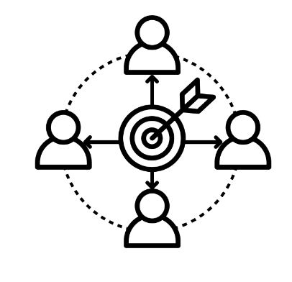


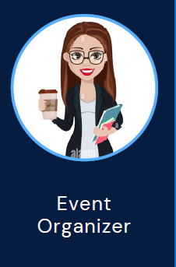

Facelink connect
Unmet Needs
Efficiency in Networking
Customized categorization
Facial recognition for connecting people
Team 8
Anisha Patil
Divya SV
Layashree Adepu
Raghavendra Deshpande Sudeendra
Yogashree Varavani Honnegowda
Spring 2024
Customer Segments
Business Professional
Graduate Student
Event Organizer
Hiring Manager

Slide 2

Facelink connect
Unmet Needs
Creating seamless connections in the digital networking landscape, our vision for FaceLink Connect is to become the premier platform where professionals and event attendees effortlessly connect, engage, and thrive.
Efficiency in Networking
Customized categorization
Customer Segments
Facial recognition for connecting people
Business Professional
Graduate Student
Event Organizer
Hiring Manager

Slide 3




Unmet Needs
Vision
Creating seamless connections in the digital networking landscape, our vision for FaceLink Connect is to become the premier platform where professionals and event attendees effortlessly connect, engage, and thrive.
Spring 2024
Customer Segments

Slide 4
Vision
Storyboard
Q1
Q2
Creating seamless connections in the digital networking landscape, our vision for FaceLink Connect is to become the premier platform where professionals and event attendees effortlessly connect, engage, and thrive.
Initial Launch
Implement strategies to increase user interaction and retention
Publicizing and customer outreach
In App Messaging Update
Offer In-app advertising to generate revenue
Go Live & User Onboarding
User Engagement
Feature Enhancement
Expansion & integration
Monetization

Slide 5
Product Roadmap
Q1
Q2
Q3
Q4
Q1
Go Live & User Onboarding
Initial Launch
Implement strategies to increase user interaction and retention
Integration with CRM Systems
Boost revenue by offering a premium subscription
User Engagement
Third-Party API Integration
Publicizing and customer outreach
In App Messaging Update
Feature Enhancement
Strategic Partnerships and Collaborations
Offer In-app advertising to generate revenue
Expansion & integration
Monetization

Slide 6



Key Product Features
Product Roadmap
Q1
Q2
Q3
Q4
Q1
Initial Launch
Implement strategies to increase user interaction and retention
Go Live & User Onboarding
Integration with CRM Systems
Boost revenue by offering a premium subscription
User Engagement
In App Messaging Update
Third-Party API Integration
Publicizing and customer outreach
Feature Enhancement
Strategic Partnerships and Collaborations
Offer In-app advertising to generate revenue
Expansion & integration
Monetization
Event Integration
In-app Messaging
Categorization

Slide 7









Attendee List
Explore More Events
Profile View
Event History
MVP Launch Features
Key Product Features
Product Roadmap
Q3
Q4
Q1
Go Live & User Onboarding
Integration with CRM Systems
Boost revenue by offering a premium subscription
User Engagement
Third-Party API Integration
Feature Enhancement
Strategic Partnerships and Collaborations
Event Integration
In-app Messaging
Categorization
Expansion & integration
Monetization
Spring 2024
Account Registration
Profile Setup
Current Events Page
Event Venue Layout

Slide 8



Key Product Features
MVP Launch Features
Number of logins, time spent, and features utilized
Account Registration
Profile Setup
Current Events Page
Event Venue Layout
% of users who continue to use app over time
Adoption rate of face link connect by event organizers
Attendee List
Explore More Events
Profile View
Event History
Spring 2024
Key Metrics
Event Integration
In-app Messaging
Categorization

Slide 9

Operational Needs
Attendee List
Explore More Events
Profile View
Event History
MVP Launch Features
Key Metrics
Number of logins, time spent, and features utilized
Risk and Management
Marketing and Sales
% of users who continue to use app over time
Customer Service
Regulatory Compliance
Adoption rate of face link connect by event organizers
Customer Relationship Management(CRM) Tools
Collaboration & Communication Platforms
Account Registration
Profile Setup
Current Events Page
Event Venue Layout
Risk and Management
Marketing and Sales
Customer Service
Regulatory Compliance
Customer Relationship Management(CRM) Tools
Collaboration & Communication Platforms

Slide 10

Operational Needs
Number of logins, time spent, and features utilized
Risk and Management
Marketing and Sales
% of users who continue to use app over time
Customer Service
Regulatory Compliance
Adoption rate of face link connect by event organizers
Customer Relationship Management(CRM) Tools
Collaboration & Communication Platforms

Slide 11




Operational Needs
Projected Costs
Fixed Costs
Total Office Space - $7.2K
Operational Costs
Total Salaries - $136K
Project/Initiative Costs:
Development, Testing, Compliance: $15K
Marketing & Outreach: $20K
Initiatives Total: $60K
Risks | Solution
Data Security | Implement robust security to protect user data
Legal Concerns | Staying vigilant with legal compliance
User Adoption | Educate users about benefits, privacy, and data transparency
Existing Competition | Innovate and prioritize user experience
Total Cost – $238K
Note: All the calculations are considered for 6 months
Risk and Management
Marketing and Sales
Customer Service
Regulatory Compliance
Customer Relationship Management(CRM) Tools
Collaboration & Communication Platforms

Slide 12
Addressing Risks
Risks | Solution
Data Security | Implement robust security to protect user data
Legal Concerns | Staying vigilant with legal compliance
User Adoption | Educate users about benefits, privacy, and data transparency
Existing Competition | Innovate and prioritize user experience
Fixed Costs
Total Office Space - $7.2K
Operational Costs
Total Salaries - $136K
Project/Initiative Costs:
Development, Testing, Compliance: $15K
Marketing & Outreach: $20K
Initiatives Total: $60K
Total Cost – $238K

Slide 13
Risks | Solution
Data Security | Implement robust security to protect user data
Legal Concerns | Staying vigilant with legal compliance
User Adoption | Educate users about benefits, privacy, and data transparency
Existing Competition | Innovate and prioritize user experience

